Slide 1

Uncovering User Behavior: Smart Device Insights for Bellabeat Growth
Presented by: Tosin Folorunso
Date Created: May, 2025

Slide 2
Table of Content
Uncovering User Behaviour
Problem & Objective
Analytical goals
Data story
Summary
Recommendation

Slide 3
Problem & Objective
Problem
Objective
limited insight into the broader patterns of how consumers interact with fitness devices
Analyze Fitbit data to identify users' activity trends, enabling Bellabeat to devise informed marketing strategies

Slide 4
Analytical Questions
Analytical Questions
WHAT are some trends in smart device usage?
HOW could these activity trends help influence Bellabeat’s marketing strategy?

Slide 5
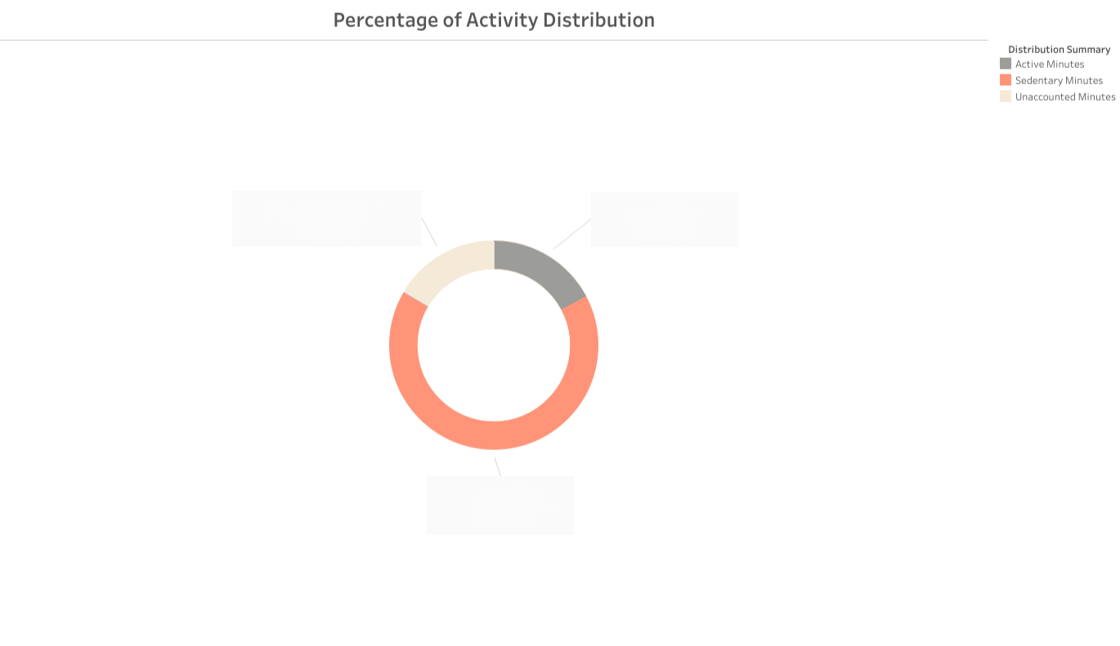
Data Story
WHAT
Unaccounted Hours
16.50%
Active Hours
17.20%
High Sedentary Time
Total Hours
100%
Users spend 66.30% (about 16Hrs of 24Hrs) in sedentary behavior
Sedentary Hours
66.30%

Slide 6
Data Story
HOW
Introduce “Move More” reminders and short, guided activities
Unaccounted Hours
16.50%
Active Hours
17.20%
Total Hours
100%
Benefit
This will position Bellabeat as a proactive wellness companion not just a fitness tracking app
Sedentary Hours
66.30%

Slide 7
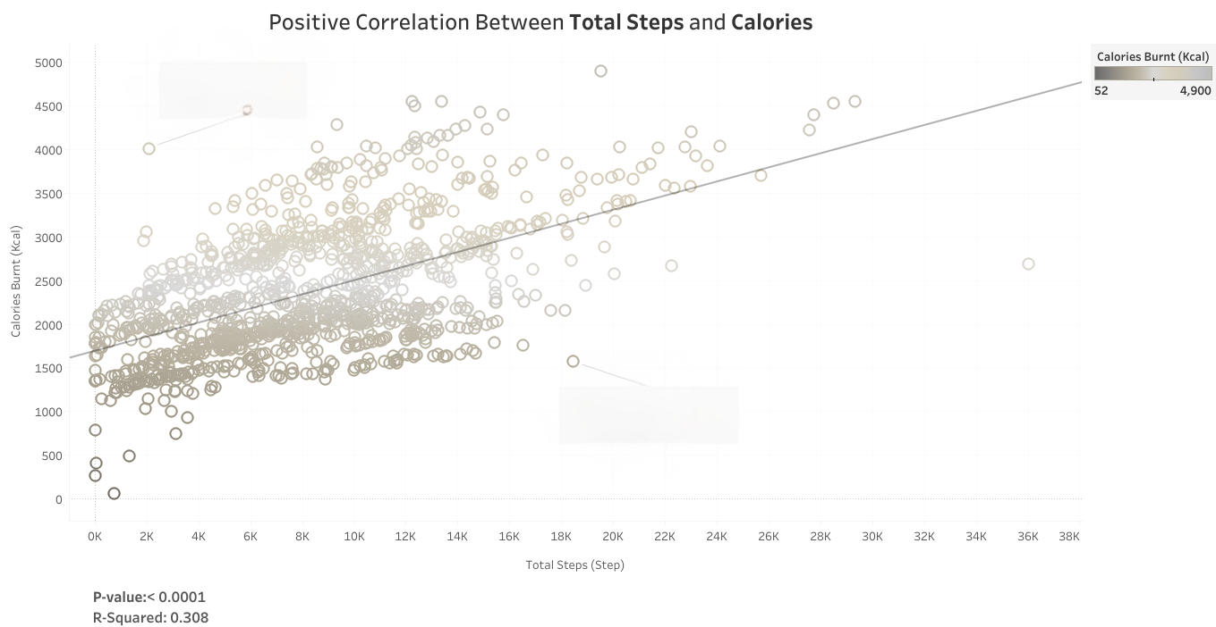
Data Story
WHAT
The More Steps You Take, The More Calories You Burn
Positive Correlation Between Steps and Calories Burnt
Users who take more steps tend to burn more calories
Calories
Steps

Slide 8
Data Story
WHAT
The More Steps You Take, The More Calories You Burn
Promote step-based challenges and set daily step goals in the app
Benefit
Calories
This will drives engagement with measurable outcomes
Steps

Slide 9
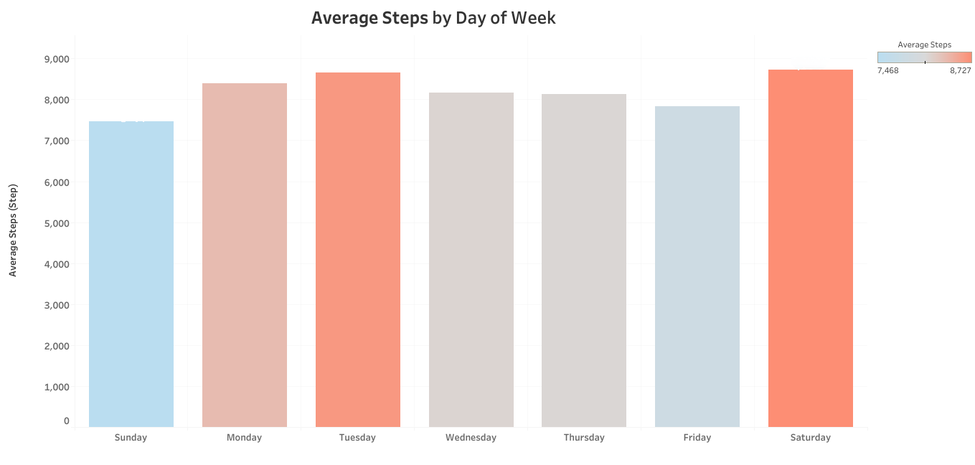
Data Story
WHAT
Daily activity trend
Users are most active on Mondays, Tuesdays and Saturdays

Slide 10
Data Story
HOW
Schedule weekly campaigns, tips, or flash deals to drop on Mondays, Tuesdays and Saturdays
Benefit
Boosts open rates and app activity by aligning with user rhythm

Slide 11
Summary
Summary
WHAT
Users spend about 16Hrs of 24Hrs in sedentary behavior
Users who take more steps tend to burn more calories
Users are most active on Mondays, Tuesdays and Saturdays

Slide 12
Summary
Summary
HOW
Introduce “Move More” reminders and short, guided activities
Promote step-based challenges and set daily step goals in the app
Schedule weekly campaigns, tips, or flash deals to drop on Mondays, Tuesdays and Saturdays

Slide 13
Thank You!!

